Slide 1
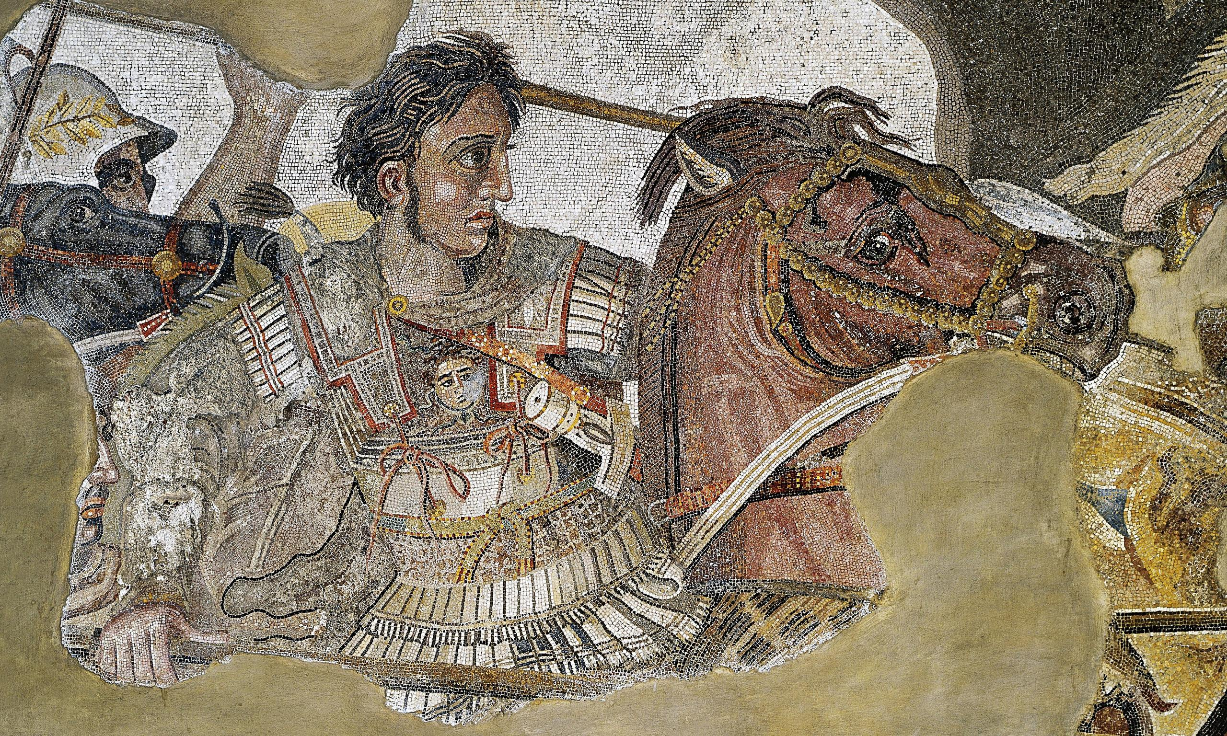
REVISION – Source Analysis
Goal/s:
Revise for source analysis task 1
Week 2 Lesson 4 – unit 2
Ms Barrie

Slide 2
Thursday 3rd August (Week 3) Session 3
Assessment task 1 – Source analysis

Slide 3
Three Revision Lessons
Revision Lesson 1 - Friday:
Source Analysis Questions
Analyse Sample Answers
Quiz
Revision Lesson 2 - Tuesday:
Steps for Source Analysis
Review SA questions
Quiz
Revision Lesson 3 - Wednesday:
Revise ATG content
Practice SA questions
Quiz
NO EXCUSES!

Slide 4
Source Analysis Questions
Read through the worksheet together as a class
Summarise the steps
Mark/Analyse the sample answers

Slide 5
QUESTION 1 – Sample Answer
Tick one (1) of the following in (a) and (b) to best describe Source 1. (2 marks)
ancient source x
modern source ☐
AND
written source x
archaeological source ☐
map/diagram ☐
reconstruction ☐

Slide 6
QUESTION 2 – Sample Answer
The focus of source 1 is Alexander the Great and his impacts on the economy (Macedonian and Persian). Alexander had a lot of power gained from his father, and he used this power to make many changes and reforms to the Macedonian economy. This also included changing the coins, and had a larger impact on the economies of other civilisations, such as trading nations and Persia. The changes of currency helped Macedonia to trade more internationally, building the wealth of Alexander’s empire.

Slide 7
QUESTION 3 – Sample Answer
The message of Source 2 is that Alexander had such a significant impact on the economy and Macedonia that he was even printed on the coins. We can see here that Alexander’s face is printed on the coins – this was an early form of propaganda as ATG would have been in control of the currency. He was spreading he was in control of Persia and surrounding areas, without having to do a massive campaign to inform all citizens.

Slide 8
QUESTION 4 – Sample Answer
Both sources represent the economic impacts of Alexander the Great. Source 1 represents Alexander’s motivations. It is a written source which highlights Alexander’s late economic ambitions, after his rise to power in Macedon. It shows an initial lack of fear about Alexander, with the revolts of city-states within Greece.
Source 2 represents the warrior and skilled military and political leader Alexander has become. It is a coin which is used as a form of propaganda to show how powerful and known Alexander was. The coin shows Alexander with the lion pelt/head as a helmet. It represents Alexander as the leader of the Macedonians, Greeks and Persian empire now, so it is after the death of Philip but it also shows Alexander’s connection with the gods.
This could also show interpretations about Alexander’s powers in the military arena as he had never been defeated and as this is a coin which would have been passed around in circulation

Slide 9
QUESTION 5 – Sample Answer
Two major changes that occurred were the defeat of Persia and the change in currency.
Alexander defeated the Persian army and this left a lasting legacy. He won lots of battles against them, and defeated Darius II.
Alexander also reformed the money system, printing his face on coins made of gold and silver. This was a change because this has not been done to this extent before, and was also used to change people’s minds about him.

